Slide 1



Title: Hand Gesture Recognition Using Computer Vision for Sign Language
Subtitle: Real-time ASL Interpretation using MediaPipe & LSTM
presented by: Kinzang Tobgay(2K21/CO/241)
Sumpanna Acharya(2K21/CO/484)
Ugyen Wangchuk(2K21/CO/497)
Supervised By: Dr. R.K Yadav

Slide 2
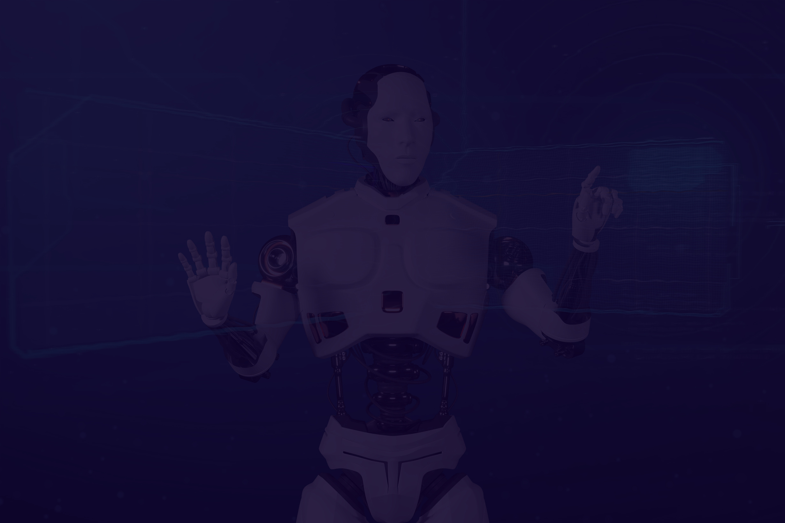

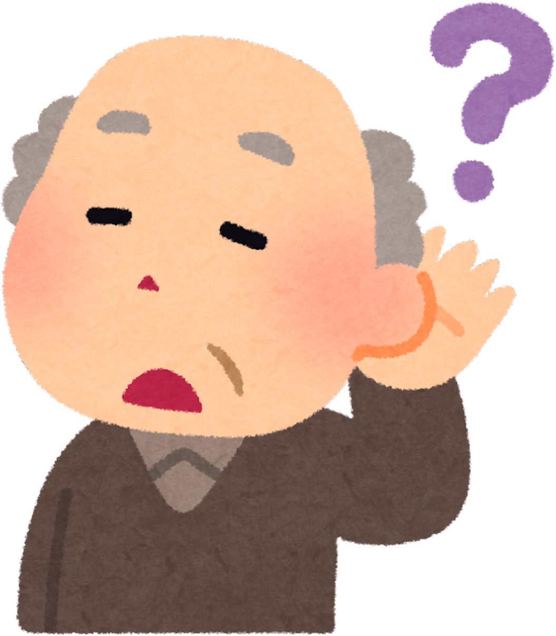
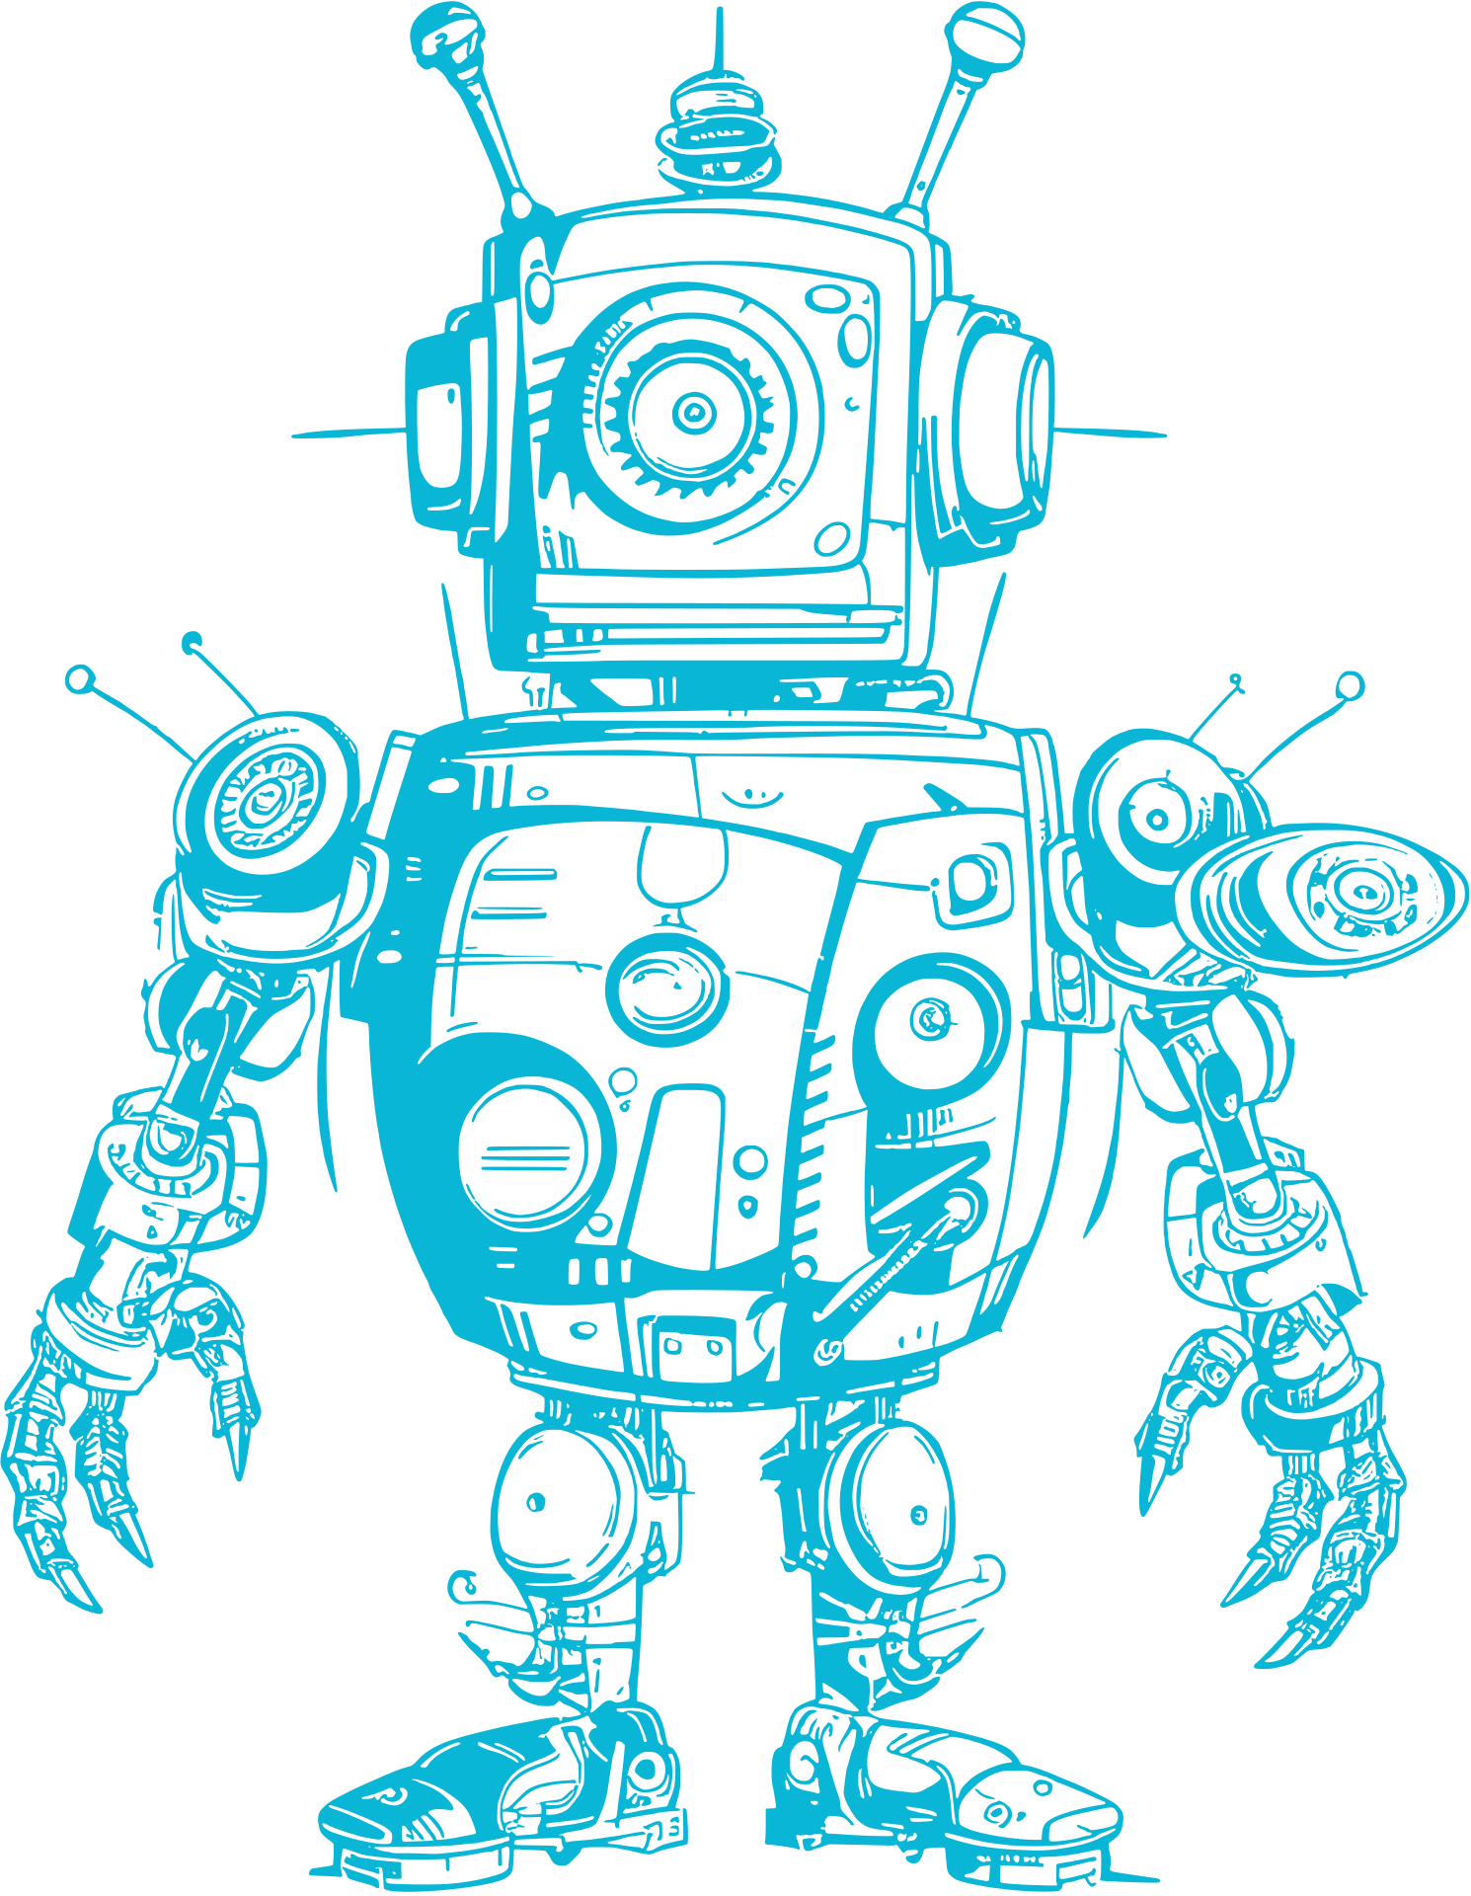
Problem Statement
Communication gap for deaf and hard-of-hearing individuals.
Lack of inclusive tech tools to translate sign language in real-time.
Inclusive for other regions such as Bhutan which has different language and system.
Need for simple system using web cams instead of sensor based and gesture based .

Slide 3

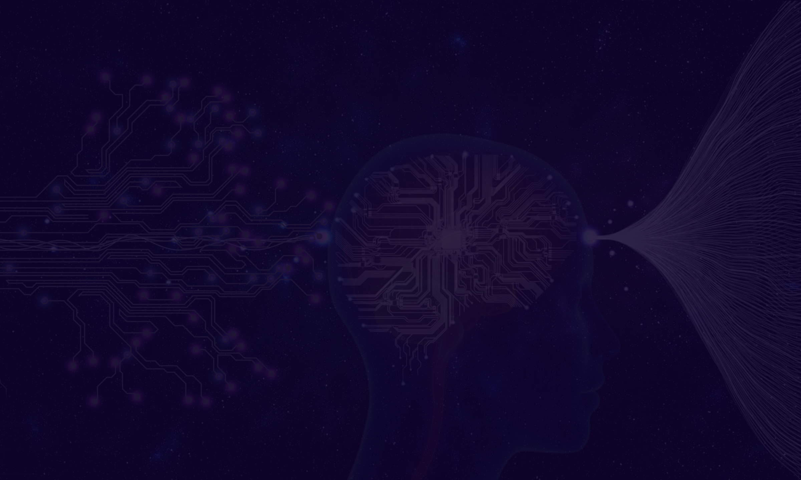
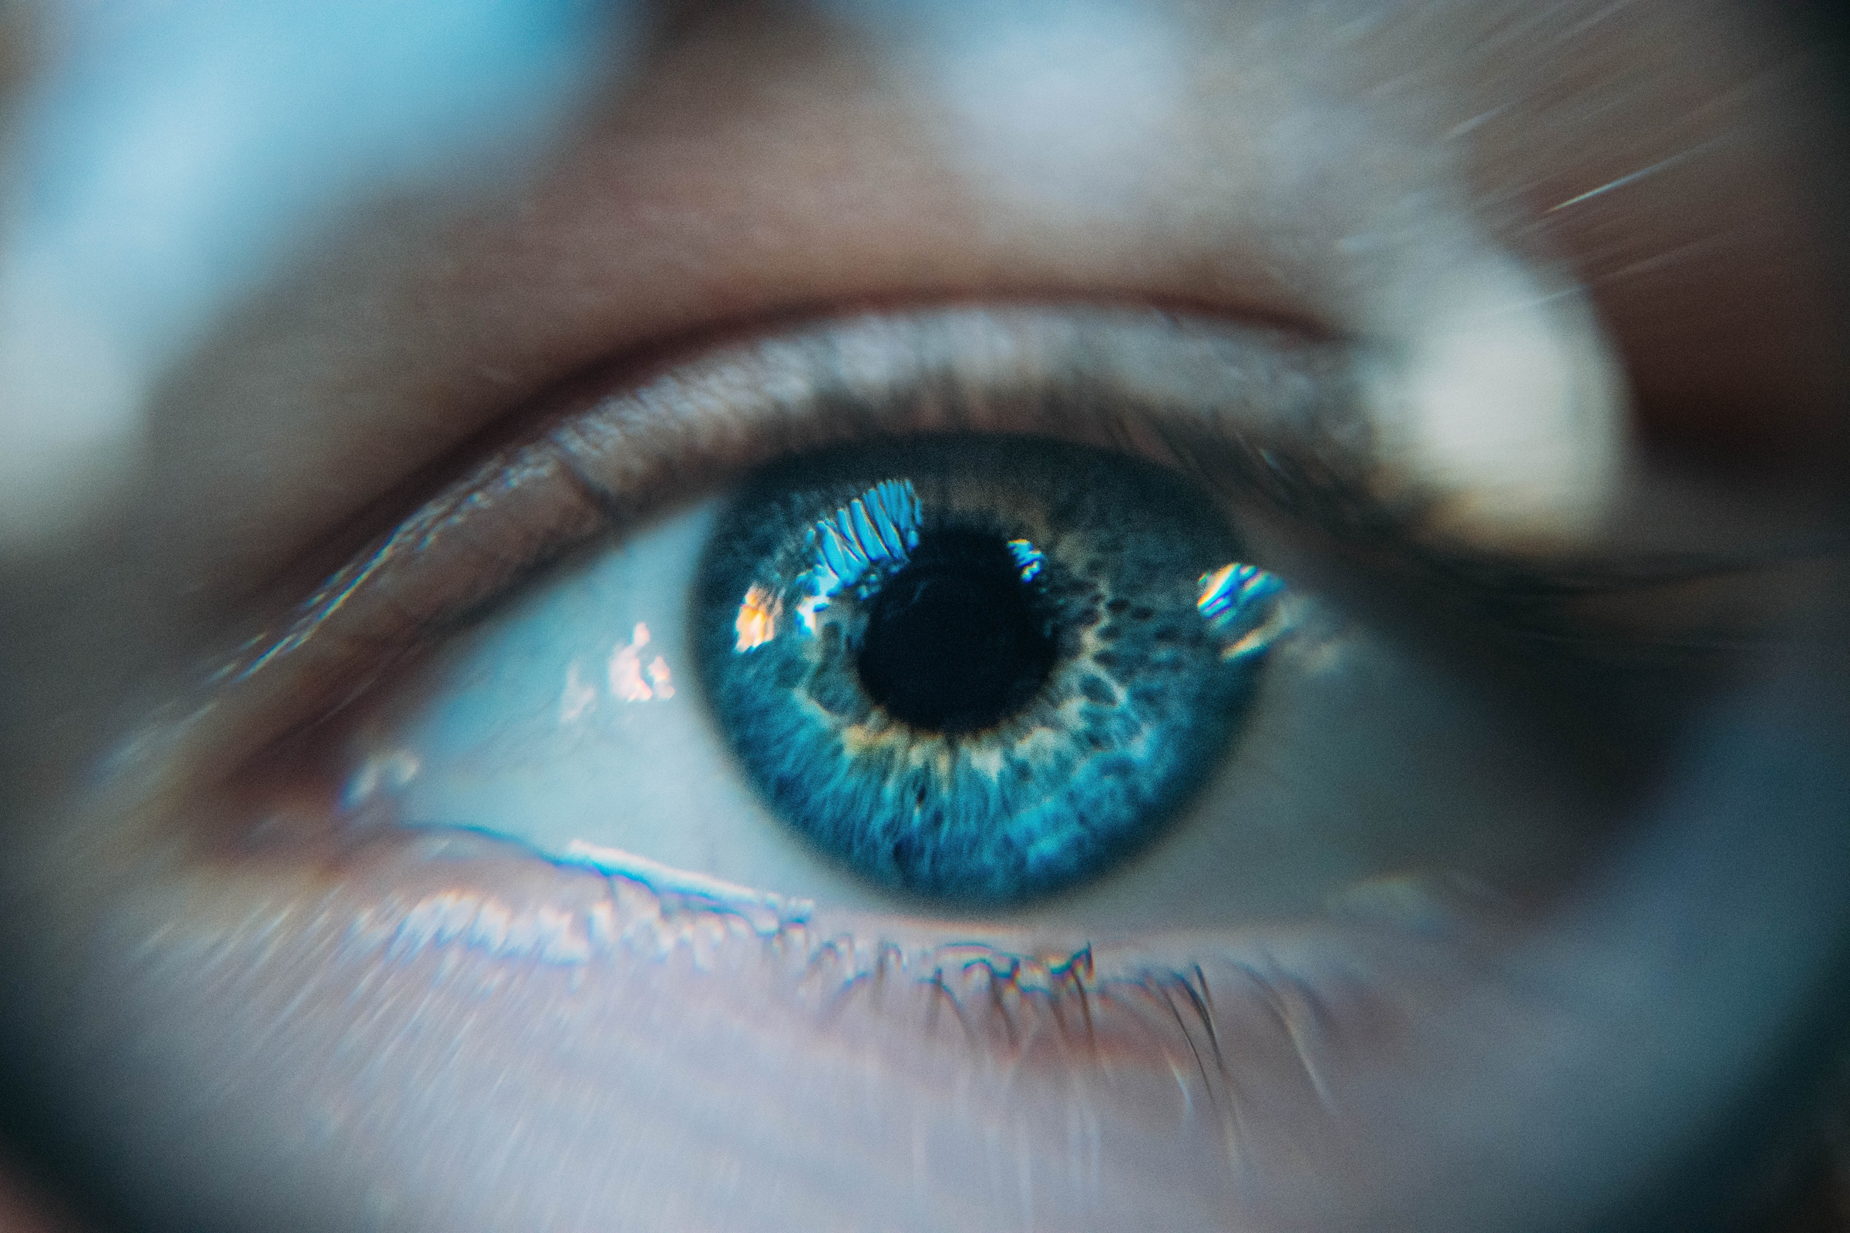
Project Objectives
Build a real-time ASL gesture-to-text/speech system.
Especially focus on dynamic gesture which is more complicated than static gestures.
Explore different model architecture and see which offers the best.
Also try incorporating another language or sign language system.

Slide 4

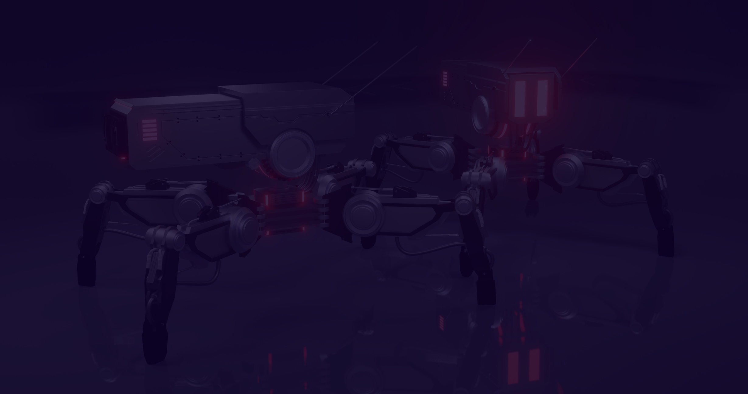
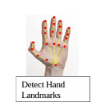
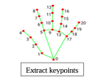
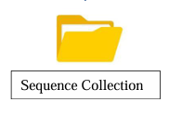
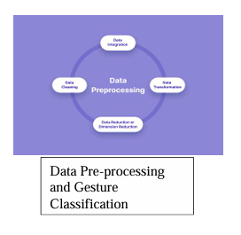
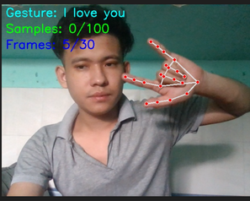
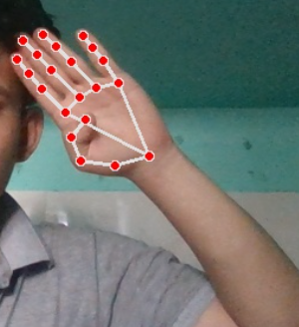
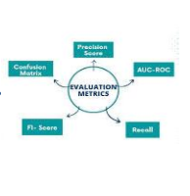
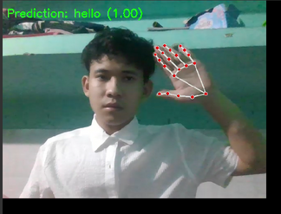
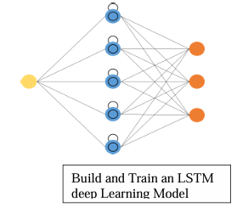
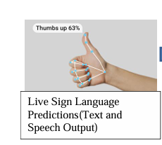
System Architecture
06

Slide 5
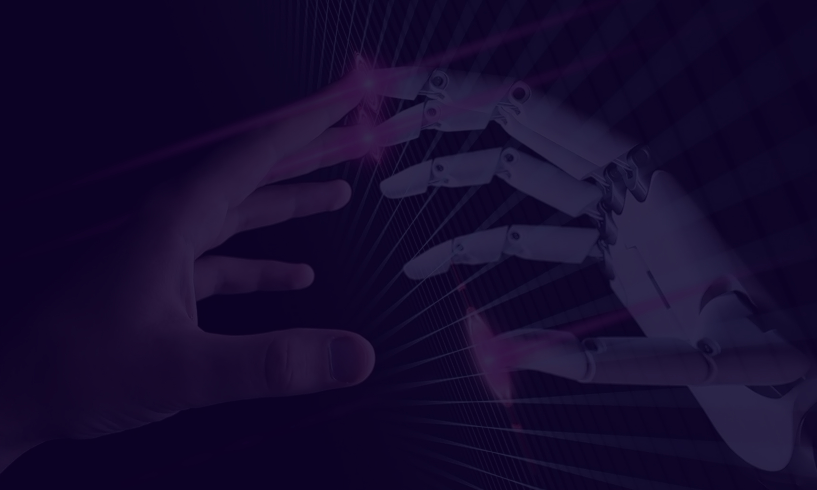

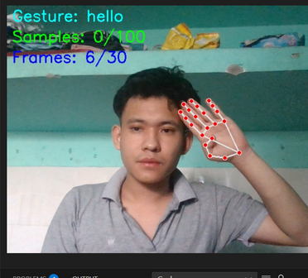
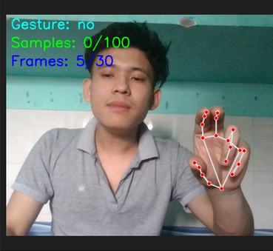
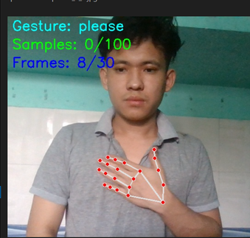
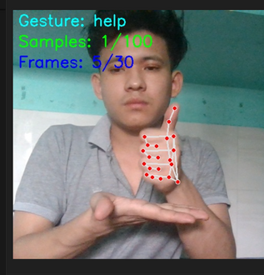
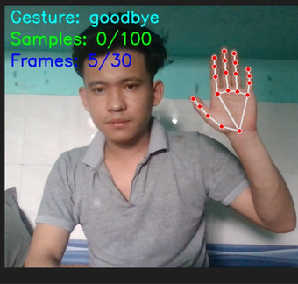
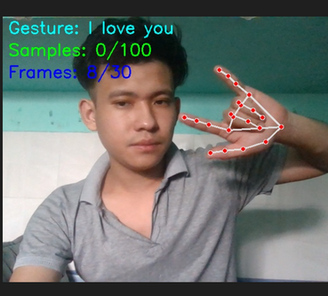

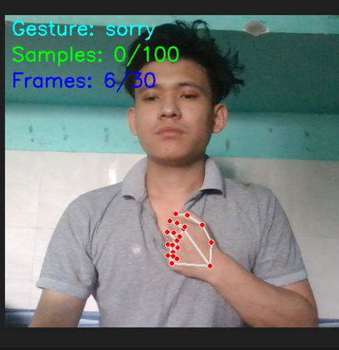
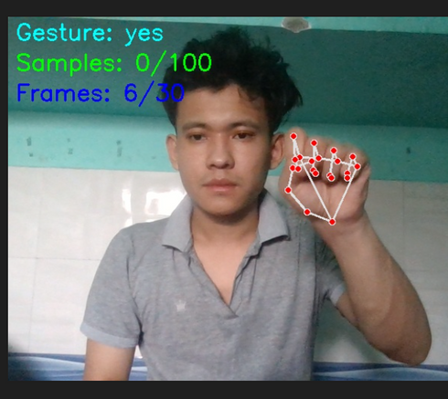
Data Collection
Captured gestures for common ASL signs (e.g., "Hello", "Yes", "No").
Diverse participants to handle demographic variation.
Ethical considerations: Informed consent, privacy ensured.

Slide 6
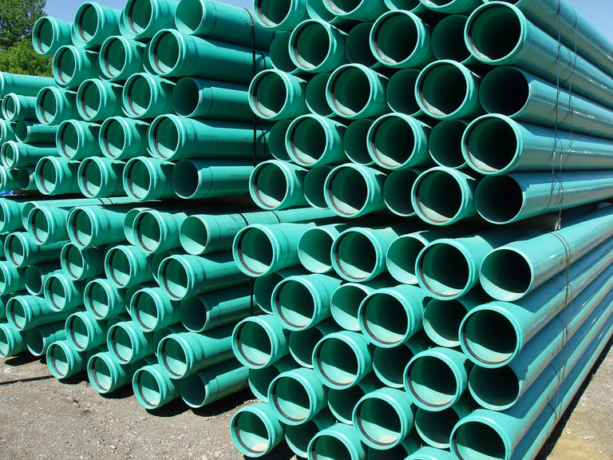
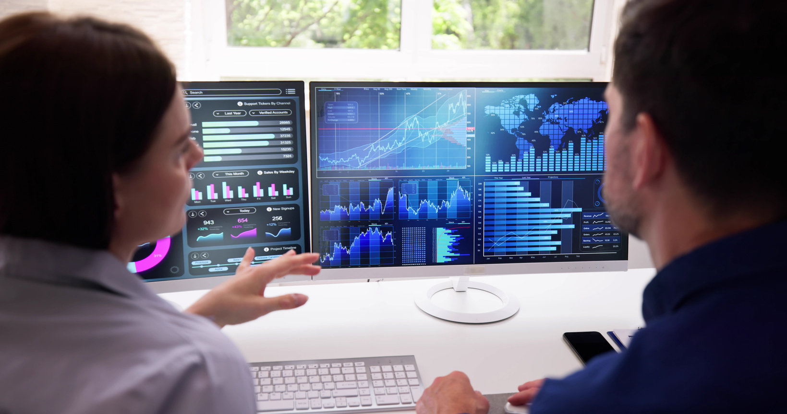
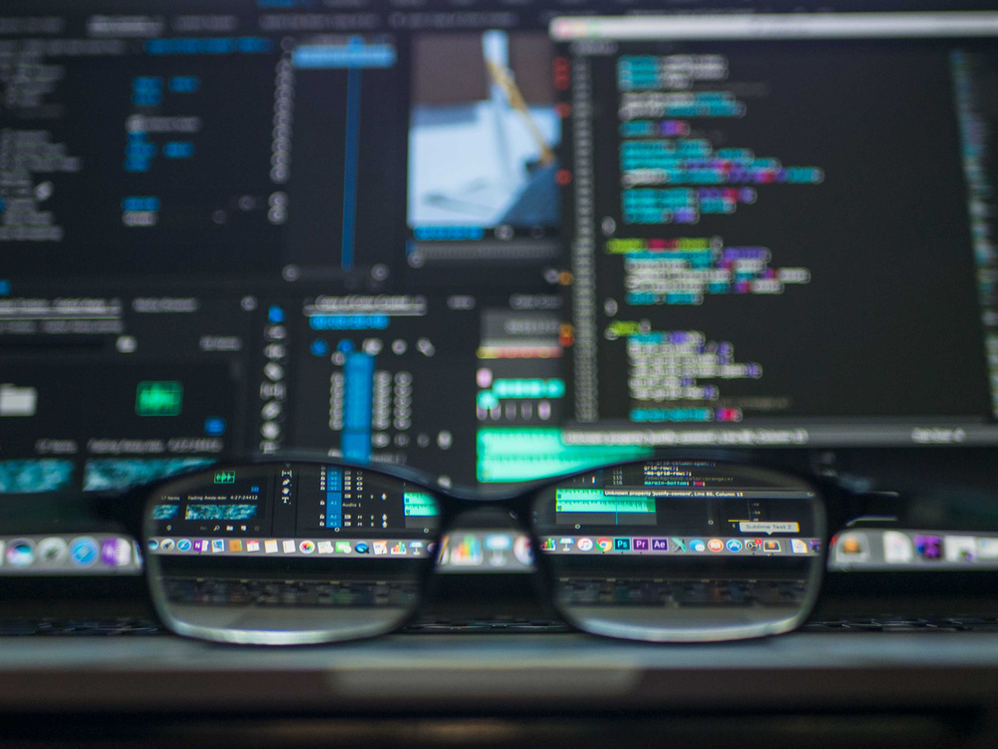
Preprocessing & Feature Extraction
04
MediaPipe:
Frame Sequencing and normalization
Output
Extracts 21 hand landmarks per frame.
Group 30 frames per gesture. Rescale and center coordinates
Clean ,labeled dataset ready for training

Slide 7

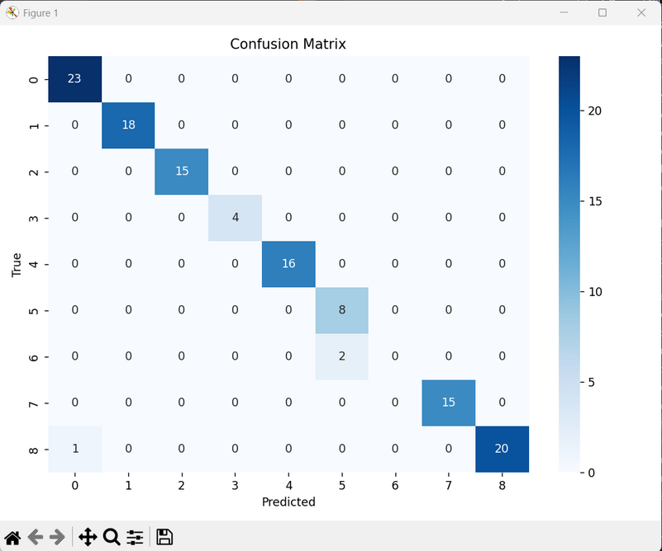
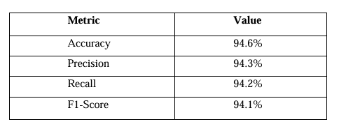
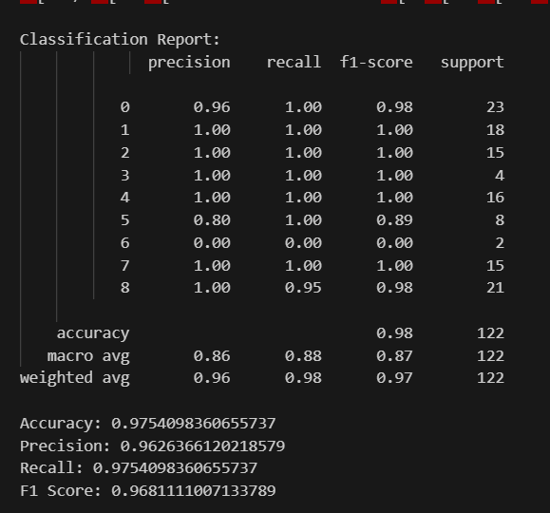
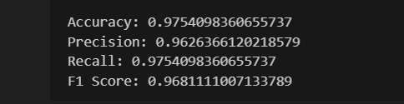
Model Training & Evaluation
1.Model: LSTM(SEquential deep Learning model)
2.Metrcis Used: Accuracy,Precision, Recall, F1 score.
Results:

Slide 8

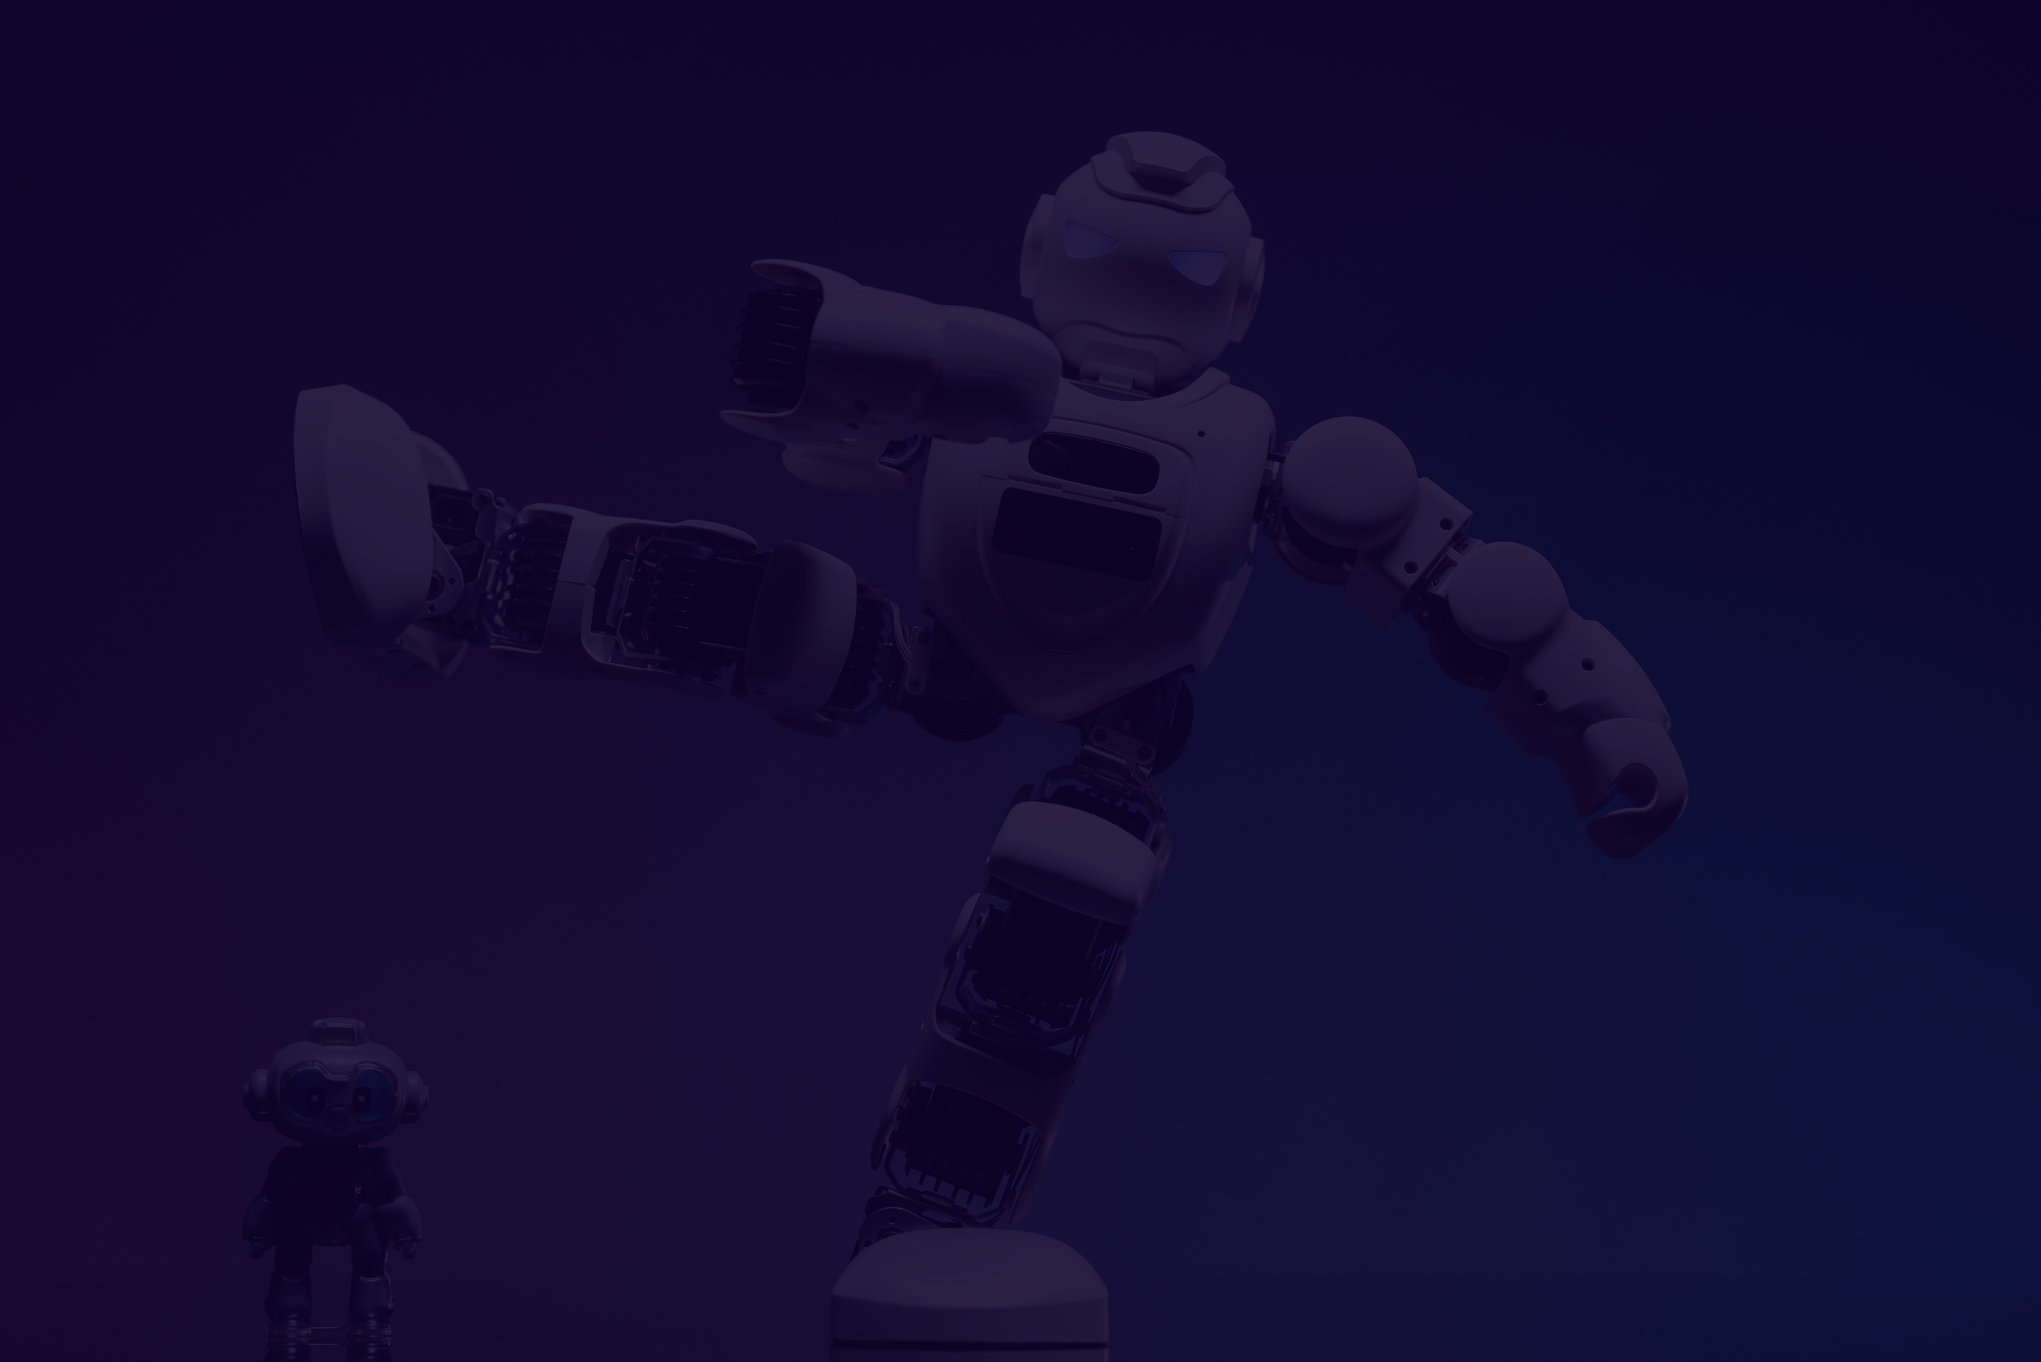


Real Time Prediction
Live webcam feed → 3D hand landmarks (MediaPipe)
Processed by LSTM → Instant gesture-to-text/speech output
Fast, responsive, and adaptable to real-world use.
Goal: Natural, instant communication for the hearing impaired.
Click Here For simulation Video

Slide 9
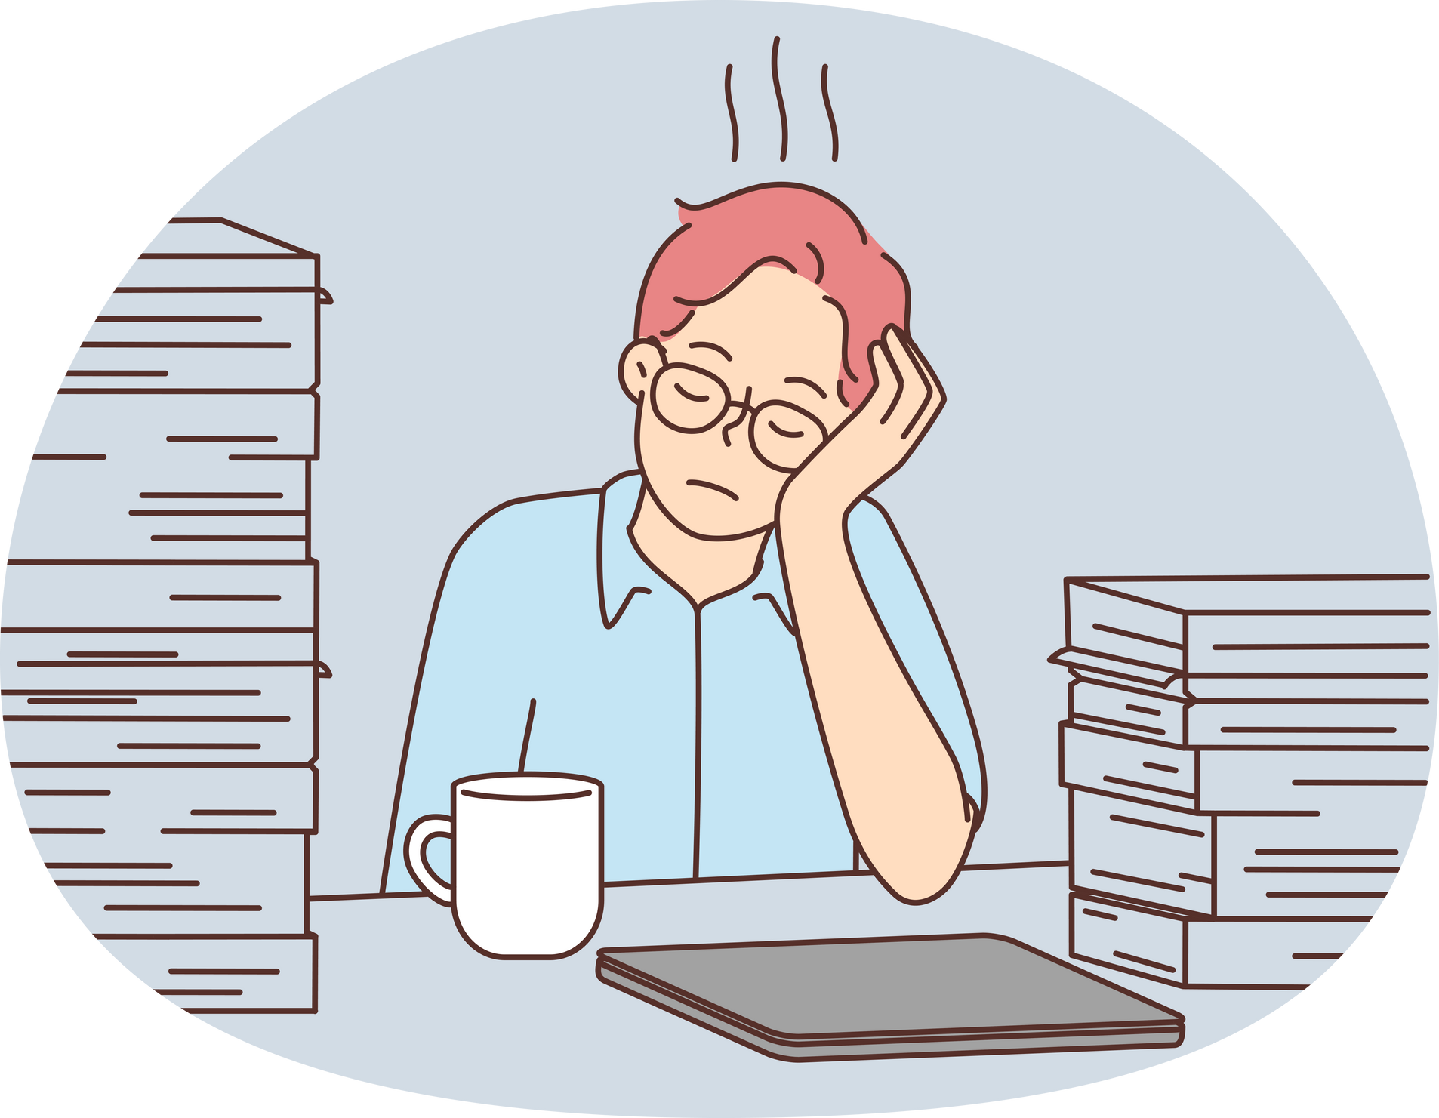
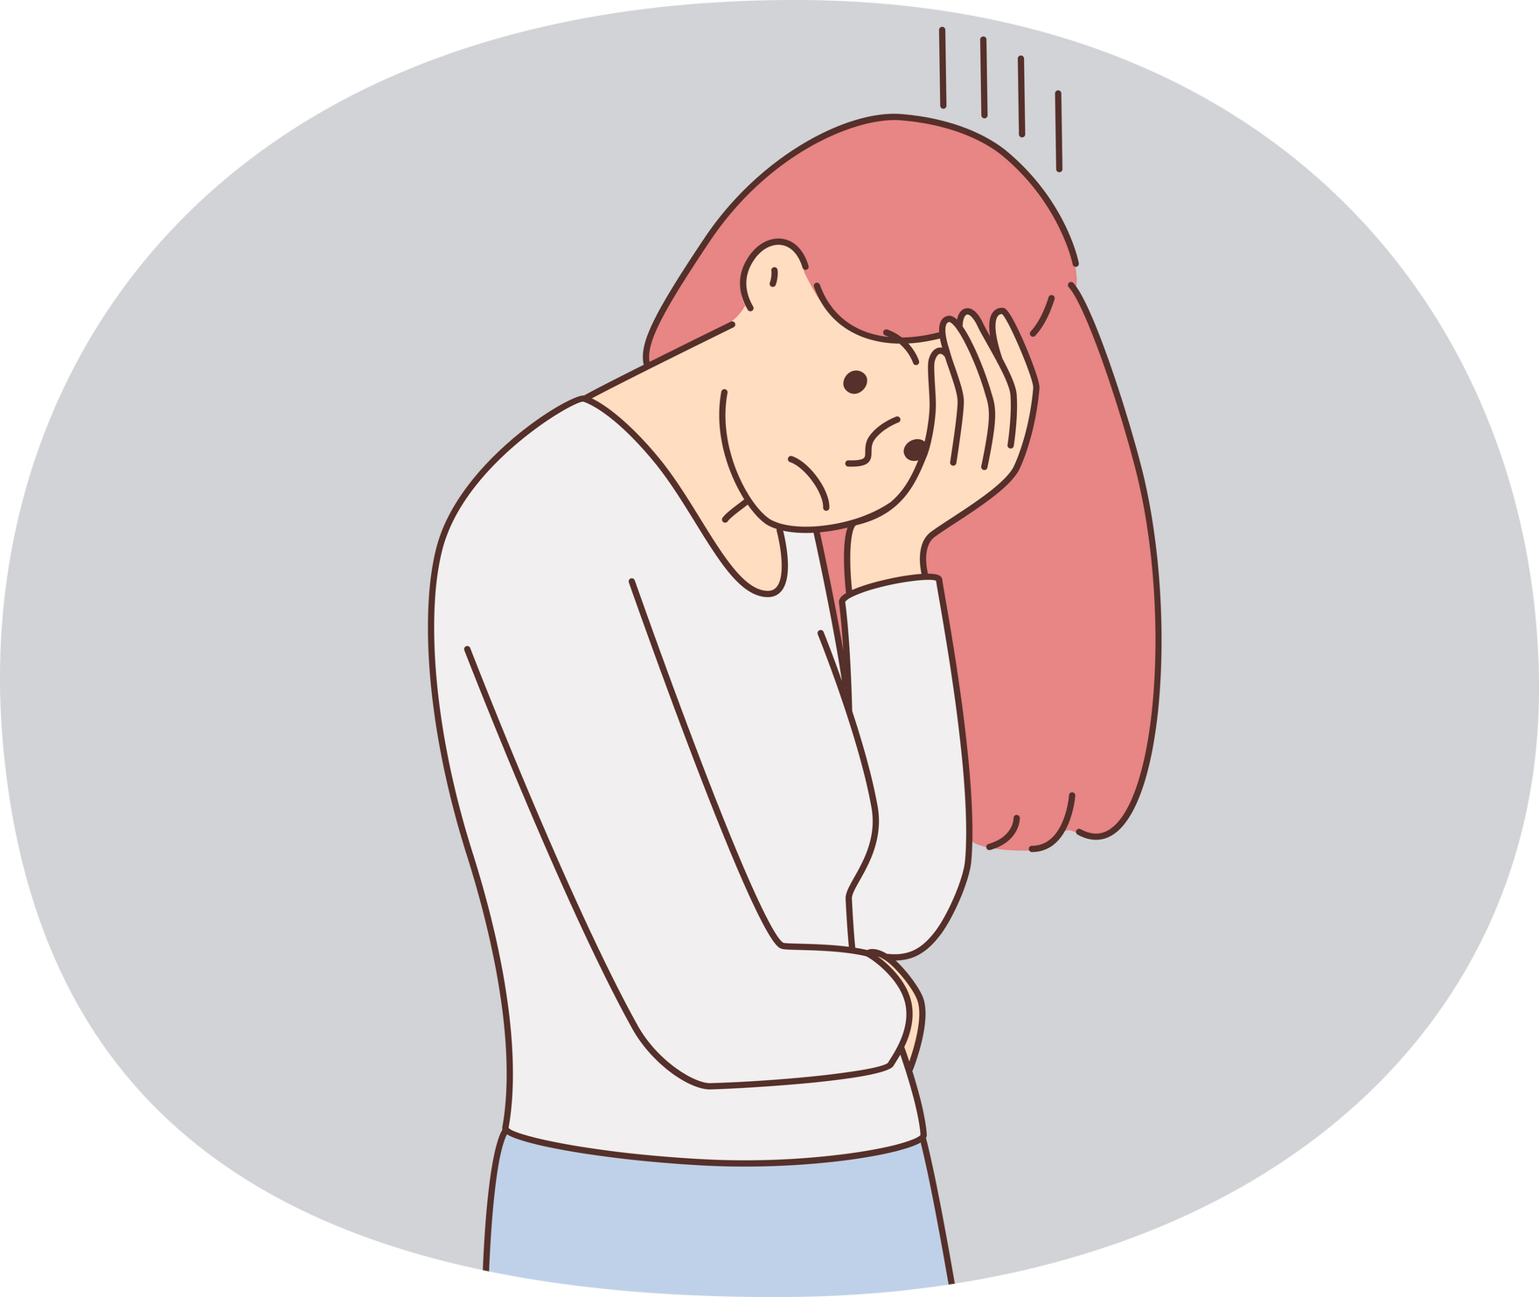
Challenges & Limitations
Varying lighting condition affect detection
Dynamic gesture need faster processing
Currently only limited gestures or signs can be translated although high accuracy
Multilingual is also in the prototype stage

Slide 10
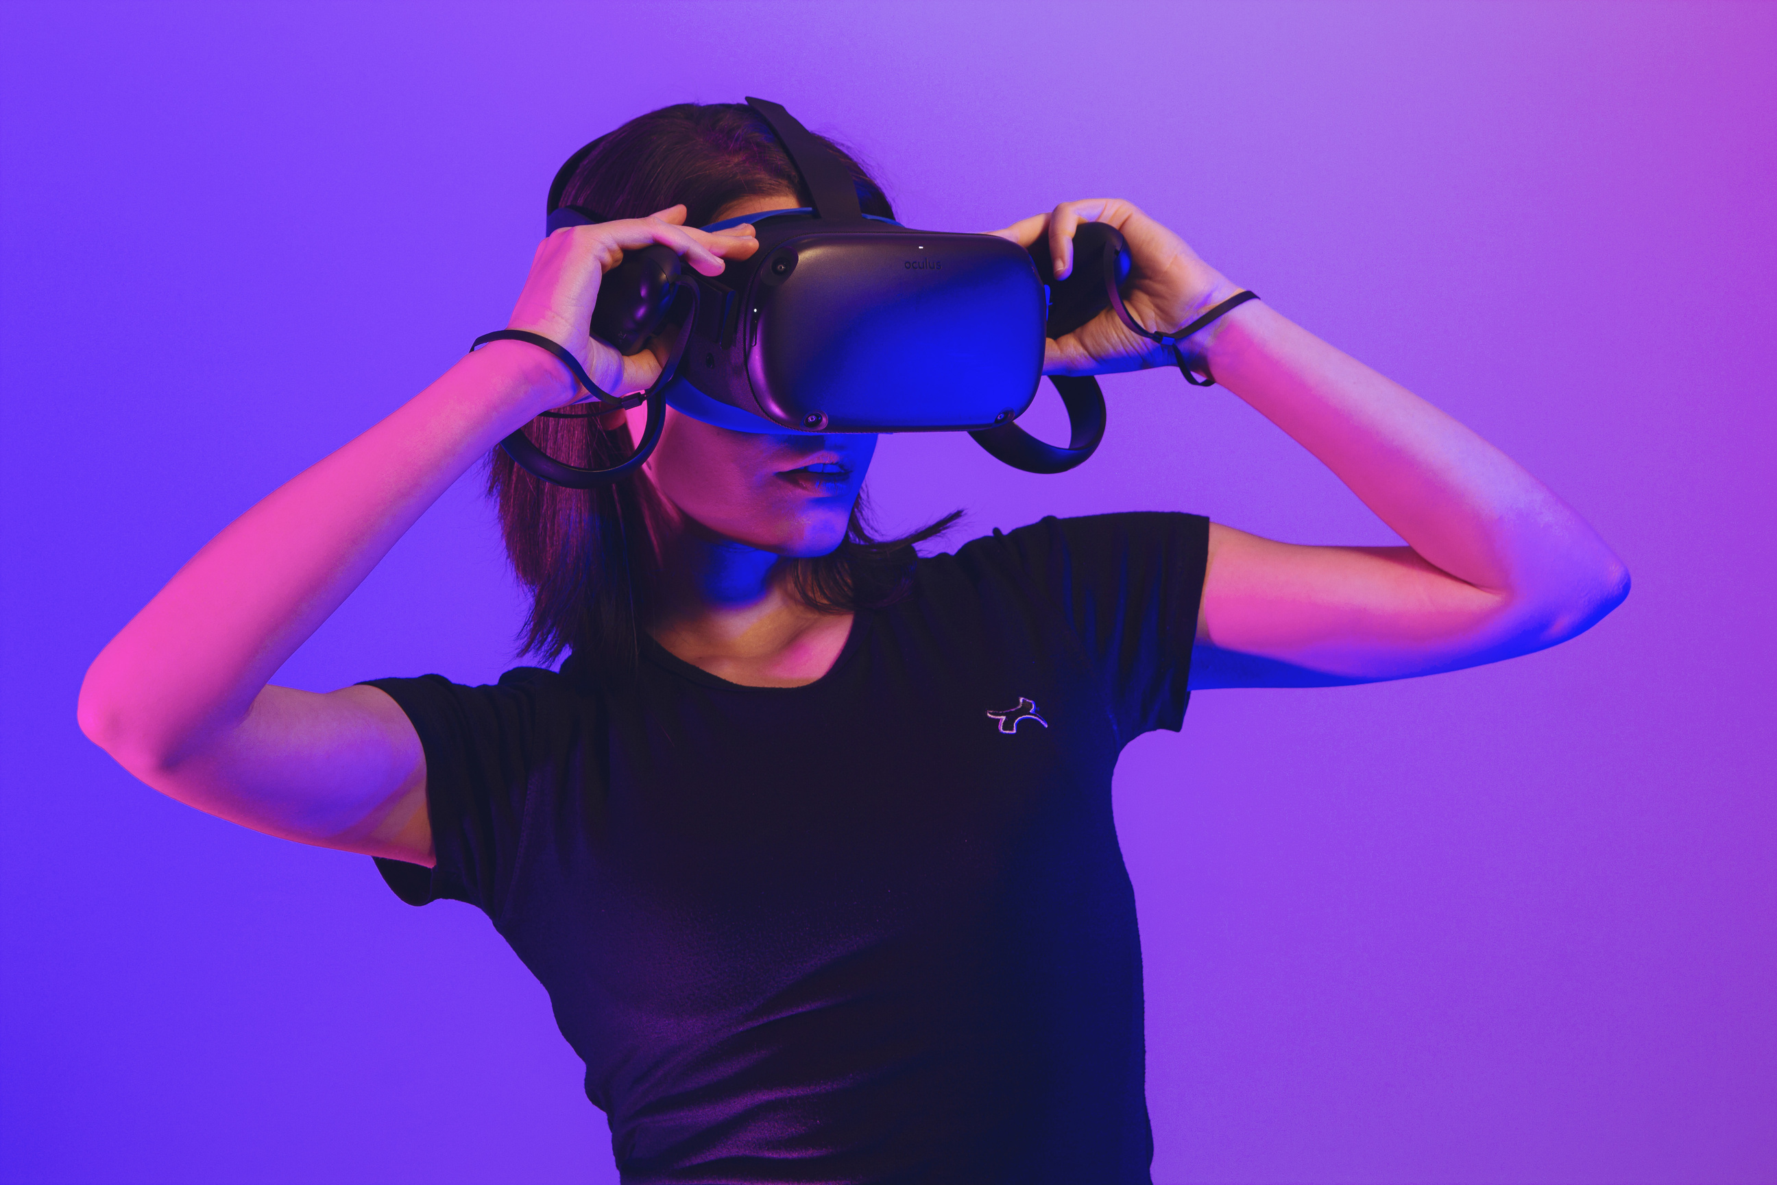
Conclusion & Future Work
Succesfully bridged basic communication gaps
Future work :
long sentences in real conversation
Multilingual translation
Integration with wearable/AR devices
Simple interface such as mobile apps
Faster processing for real time.
Goal: Inclusive, accessible AI solutions for all.

Slide 11



Thank You!

